Slide 1
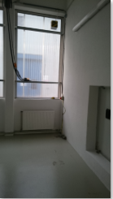
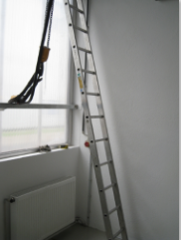
HS&E INCIDENT BULLETIN |  | 1st half year 2015
Duisburg Germany | Type of incident Fall from Height
Summary:
While an activity the used ladder slide away and the employee fell on the ground. Fracture food,
Root Causes: | Actions Taken Thus Far: Next Steps
The colleague got no instruction and no risk analyze for using ladders. He was in rush and had no support for a hold - The ground was painted recent
Planning of a local safety stand down “ladder and stepladder”
“Short safety talks” initiated by EHS.

